Slide 1
Elective Subject Computer Science in Primary School – the teachers' opinions
Irena Nančovska Šerbec, Špela Cerar, Matija Lokar and Andrej Brodnik
University of Ljubljana, Slovenia

Slide 2
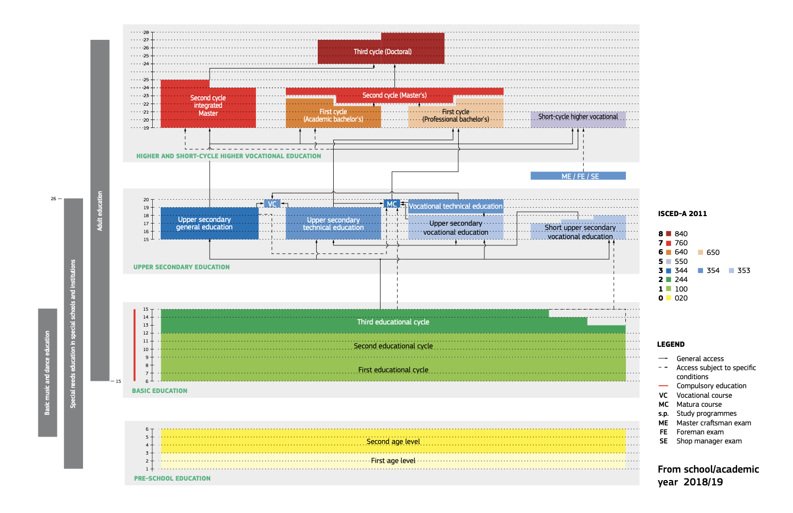

Slide 3
INFORMATICS (CS) in primary school
In Slovenian primary school, the subject of computer science (CS) is not part of the compulsory curriculum.
optional elective subject Computer science in grades 4-6 (9-12 years) since 2014
elective subjects in grades 6-9 (12-15 years):
Text editing,
Multimedia,
Computer Networks

Slide 4
InformaticS IN secondary school
One year of Informatics in the compulsory part in the upper secondary education:
70 hours - mandatory
elective subject on Matura exam

Slide 5
The state of teaching CS – worlD/ Slovenia
WORLD:
Modern CS education turns to teaching core content in the compulsory part of the curriculum and usually throughout the educational chain
SLOVENIA:
there is only one year of CS instruction in the compulsory part of general education in a grammar school, which has a fairly open curriculum.
Differences in prior knowledge at entry to upper secondary education as a result of (non)attendance of elective subjects in primary education.
Elective subject CS:
Heterogeneous groups, harder to reach standards, lack of materials, mostly develop competencies

Slide 6
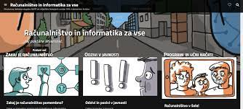
The state of teaching CS - RINOS
expert group RINOS (form 2017, convened by Ministry od edu.)
Slovene RINOS = Strokovna delovna skupina za analizo prisotnosti vsebin Računalništva in INformatike v programih Osnovnih in Srednjih šol ter za pripravo študije o možnih spremembah
which translates to English as an Expert working group for analysis of Computer Science topics presence in primary and secondary schools, and for a preparation of proposal of possible changes.
In 2018, the RINOS Expert Group made a proposal, that was also approved by the The Slovenian Academy of Sciences and Arts, to change the curricula by introduction of the compulsory subject CS into primary and secondary schools.
https://www.racunalnistvo-in-informatika-za-vse.si/

Slide 7
The state of teaching CS
Working on introduction of CS as a compulsory subject from kindergarten to the end of secondary education (ISCED0-3).
Following the K12CS framework
However, shifting the focus from digital literacy to core CS concepts requires a change in teaching methods and the creation of appropriate instructional materials – properly educated teachers are the key

Slide 8
The state of teaching computer science
What are the results of the introduction of the "new" elective CS in grades 4-6?
Unfortunately, only the monitoring report for electives for the 2014/15 school years (published in 2018)
Nolimal, F., Kač, L., Krajnc, R., Fišer, G., Sotošek, G. & Breznik, G.: Poročilo za spremljanje neobveznih izbirnih predmetov za šolsko leto 2015/16 (2018). Zavod Republike Slovenije za šolstvo. https://www.zrss.si/digitalnaknjiznica/Porocilo_NIP/

Slide 9
SOme of the most interesting results

Slide 10
Feasibility and relevance of the CS elective curriculum
The questions were related to the topics of the curriculum: - Placement of the subject, - General objectives of the course, - Operational objectives and content, - Knowledge standards, - Didactic recommendations, and - Organisational, personnel, and material aspects of course delivery, - General data (gender, level of education and specialty, number of teaching groups, professional experience, title).

Slide 11
Influence of elective CS on Bebras and Pišek
Other research question:
How does participation in an elective CS affect success in the Bebras and Pišek competitions?

Slide 12
Sample
The number of respondents who completed the 2015 questionnaire was 23,
The number of respondents who completed the 2022 questionnaire was 33 (more than ½ of the respondents participated in the past).

Slide 13
CS course placement
The subject is appropriately placed in the primary school curriculum: In 2015, 70% of the respondents In 2022, 81% of the respondents Those who think it is not: -85% would place the subject in the 3rd cycle (for 12-15 year olds) -15% would place the subject between the first cycle (for 6-9 year olds) and the third cycle

Slide 14
The general goals of the curriculum (are understandable)
Clarity of the definition of subjects (overall objective): -in 2015 95.7% of respondents -in 2022 92% of respondents Achievability of learning goals: -in 2015 69.9% of the respondents
-in 2022:

Slide 15
The general objectives of the curriculum
Main reasons for not achieving the goals (2022): -the complexity 66% -other reasons 33% -too many learning objectives Other reasons for lower achievability: - the status of the course as an elective, i.e., the last hours in the schedule, - combined groups, - pupil fatigue, - less serious attitude of students towards electives.

Slide 16
We analyse the coverage of topics in the combined groups
Algorithms
Programms
Data
Problem solving
Communication and services

Slide 17
Algorithms thematic strand achieving the operational objectives (combined groups)

Slide 18
Data thematic strand achieving the operational objectives (combined groups)

Slide 19
Competitions
In which of the following competitions do your pupils in Years 4, 5 and/or 6 participate?

Slide 20
Competitions
Please rate your agreement with the following statements about the competition for Grades 4, 5 and 6
1- dissagree.. 4-agree

Slide 21
What challenges do you face when teaching CS, aside from the fact that it is an elective?
„Specifically, the problem are mixed, oversized groups of pupils with varying levels of computer literacy and cognitive development (4-6 grade levels) and the question of how to provide individualised support to each pupil in the given situation”
“Different backgrounds and ages of pupils.”
“The problems and challenges are that the groups are made up of students from different backgrounds (some have attended CS elective for a year, others for longer). It would also be better if the groups consisted of 21 children instead of 29.”

Slide 22
Conclusions
The main part of the questionnaire asked about the feasibility and relevance of the CS elective curriculum.
Teachers believe the placement of the subject is appropriate, but suggest developing digital literacies separately and moving more complex topics to the third cycle (for grades 7-9)
According to the teachers, the main reasons for poor performance are too large groups of students with heterogeneous backgrounds in the class (combined groups)
According to the teachers, participation in the elective CS affects the results of Pišek, the competition in block-based programming, but not the results of Bober, the competition in CT

