Slide 1
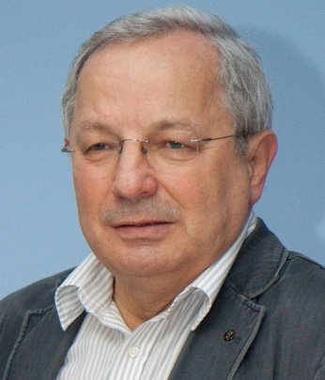
Hiroshima, WCCE 2022
1. News about K-3 teachers training
2. Spiral steps in learning programming
Maciej M. Sysło
Warsaw School of Computer Science
syslo@ii.uni.wroc.pl; http://mmsyslo.pl
https://pl.wikipedia.org/wiki/Maciej_Marek_Sysło

Slide 2
Early-school education – grades 1-3, K-3
according to the national curriculum, in K-3 all subject are called „education” (math ed, language ed, science ed), however their school implementation is integrated – teachers decide how to combine topics from various educations
CS activities usually take place where kids are playing; there is no need for a classroom fully equipped with technology; CS is integrated with other „educations” during the whole week – 1 hour of CS lasts a week; sometimes teachers take kids to comp lab
GOOD NEWS: now, several universities run FREE in-service courses (120 hours) for teachers from K-3 on informatics education in K-3
at such a course, teachers from K-3 learn block-coding, educational robotics and how to integrate informatics with other educations
a module „Informatics education in K-3” has been proposed for university faculties which prepare prospective K-3 teachers
Maciej M. Sysło
Hiroshima, WCCE 2022

Slide 3
Spiral steps in learning programming/coding
Grades
K-3, 4-8
K-3, 4-12
K-3, 4-12
4-6, 7-8
6-8
6-12
Spiral development of programming skills is in increasingly richer environments:
programming robots: students follow the designated path, draw geometric figures, appear events in reaction to sensors – they use block-programming environment
The Hour of Code, code.org – ready-made multi-thematic environment, robots on the screen, block-programming
Scratch, Blockly (in robots) – block-programming, environment moves to the cloud – important: sharing software
!!! Extract texts from blocks!!! Code.org – Scratch – Python
Turtle graphics – Python
Python/C++
We show now a „smooth” journey through various programming environments
3
Maciej M. Sysło
Hiroshima, WCCE 2022

Slide 4
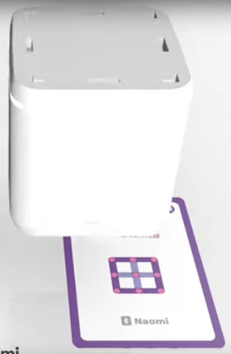
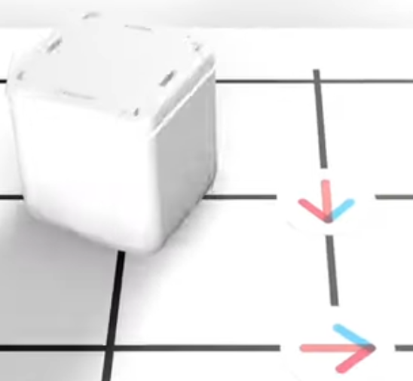
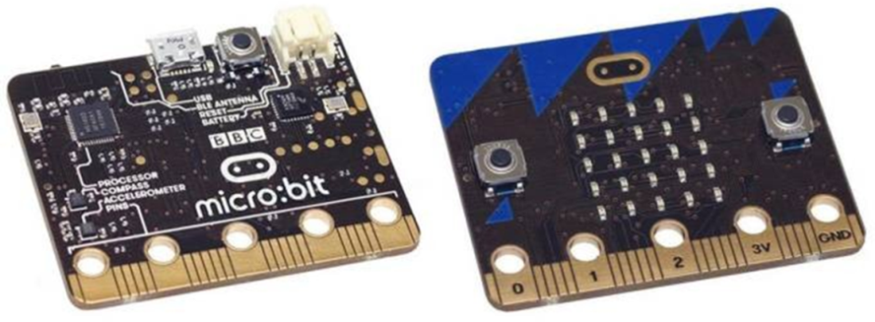
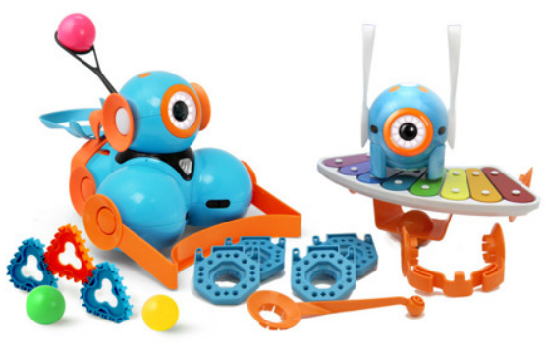
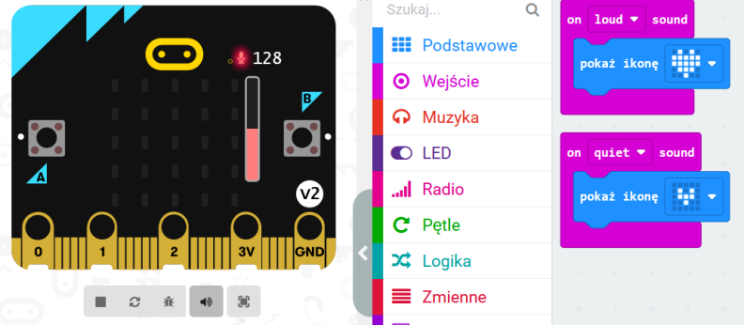
Robots, programmable – in many ways
4
Maciej M. Sysło
Hiroshima, WCCE 2022

Slide 5
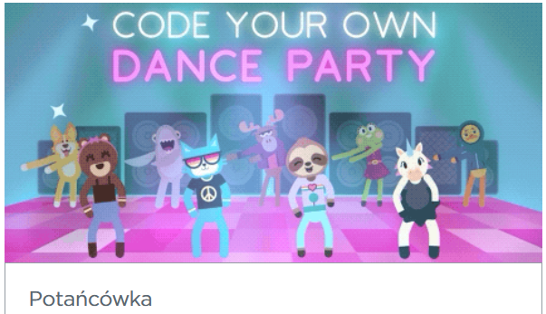
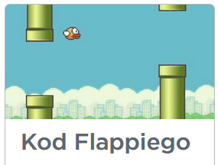
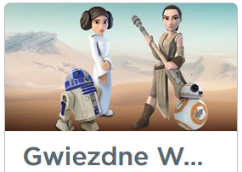
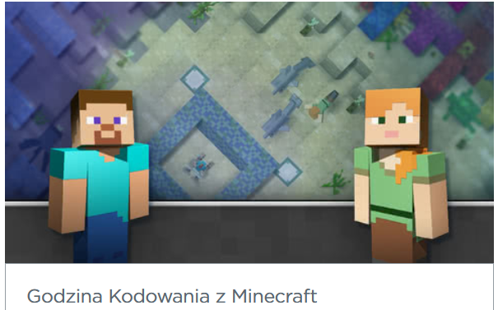
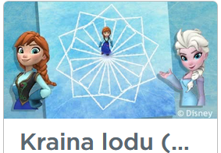
The Hour of Code – code.org
US initiative, available in Polish (I translate), active since 2013
The Hour of Code – available 24/7/365 – see http://mmsyslo.pl
Very popular in Poland – more than 635 M registered students
CS/Informatics for All
Puzzles to be solved by programming
Puzzles refer to stories known to kids
Maciej M. Sysło
Hiroshima, WCCE 2022

Slide 6
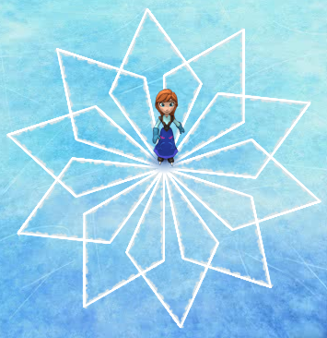
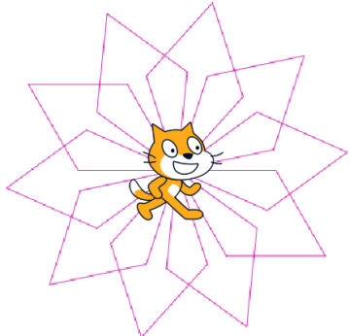
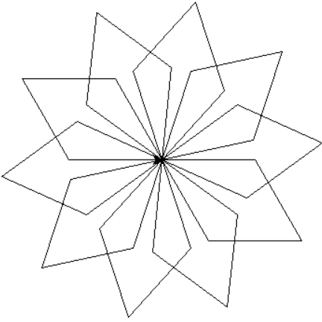
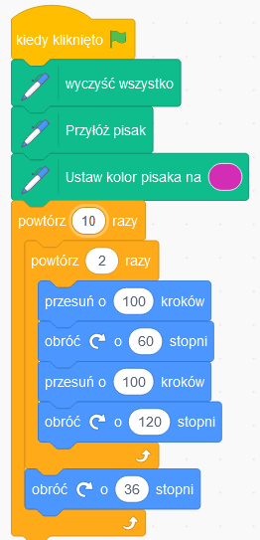
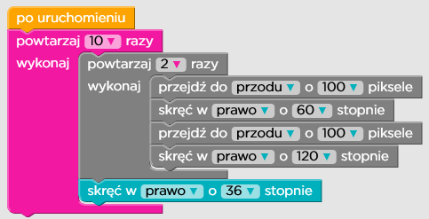
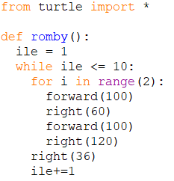
Example: code.org → Scratch → Python
A „smooth” transformation from blocks to text
The Hour of Code Scratch Turtle graphics – Python
6
Maciej M. Sysło
Hiroshima, WCCE 2022

Slide 7
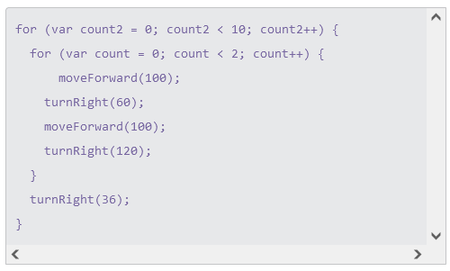
Example: code.org → text (JavaScript)
The Hour of Code – Frozen (#12) Text (JavaScript)
7
Maciej M. Sysło
Hiroshima, WCCE 2022

Slide 8
Example: code.org → text (clear)
The Hour of Code; Text – from the blocks
Exactly, what is in the blocks
powtarzaj 10 razy
wykonaj powtarzaj 2 razy
wykonaj przejdź do przodu o 100 pikseli
skręć w prawo o 60 stopni
przejdź do przodu o 100 pikseli
skręć w prawo o 120 stopni
skręć w prawo o 36 stopni
8
Maciej M. Sysło
Hiroshima, WCCE 2022

Slide 9
Example: text → Scratch
Text from Blockly
powtarzaj 10 razy
wykonaj powtarzaj 2 razy
wykonaj przejdź do przodu o 100 pikseli
skręć w prawo o 60 stopni
przejdź do przodu o 100 pikseli
skręć w prawo o 120 stopni
skręć w prawo o 36 stopni
The corresponding text in Scratch blocks
powtórz 10 razy
powtórz 2 razy
przesuń o 100 kroków
obróć „w prawo” o 60 stopni
przesuń o 100 kroków
obróć „w prawo” o 120 stopni
obróć „w prawo” o 36 stopni
Text (from the Hour of Code) Scratch
9
Maciej M. Sysło
Hiroshima, WCCE 2022

Slide 10
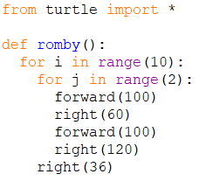
Example: Scratch → Python
Scratch; Turtle graphics – Python
Text in Scratch blocks
powtórz 10 razy
powtórz 2 razy
przesuń o 100 kroków
obróć „w prawo” o 60 stopni
przesuń o 100 kroków
obróć „w prawo” o 120 stopni
obróć „w prawo” o 36 stopni
Students are advised:
to make a table with corresponding commands in various programming environments.
Modifications (with a bit of math):
different figures, side sizes, angles
different numbers of figures – introduction of variables
10
Maciej M. Sysło
Hiroshima, WCCE 2022

Slide 11
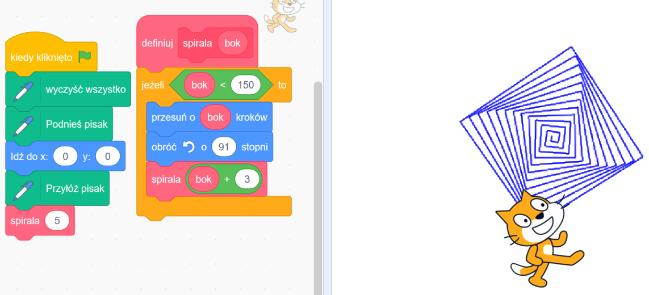
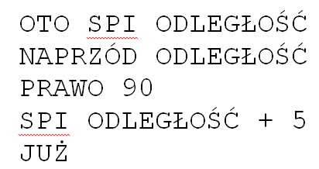
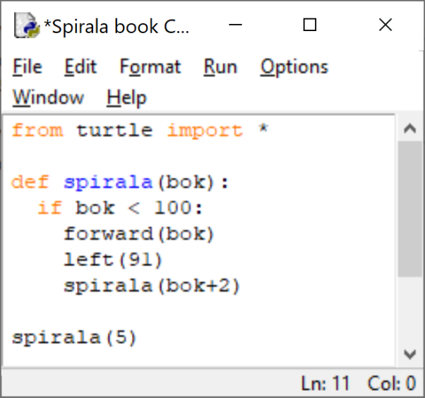
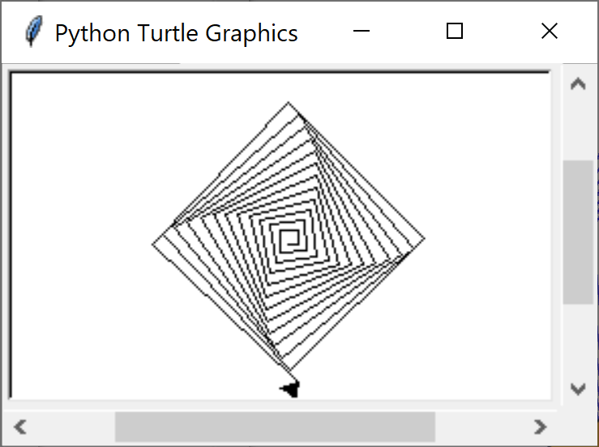
All started with Papert
S. Papert, 1980
Tail recursion
Maciej M. Sysło
Hiroshima, WCCE 2022

Slide 12
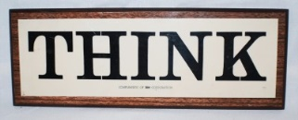
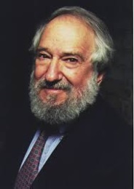
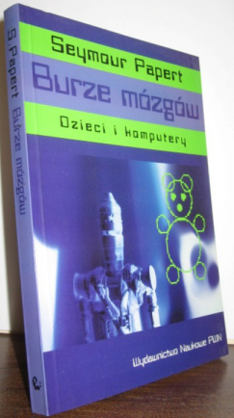
Constructionism
Logo IBM, 1924
1970 (WCCE in Amsterdam):
children learn by doing and
by thinking about what they do
constructivism, constructionism
computational thinking
Maciej M. Sysło
Hiroshima, WCCE 2022

Slide 13
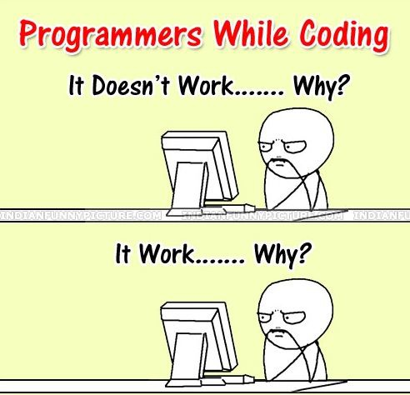
Constructionism in programming
It doesn’t work … why?
[Debug it]
It works … why?
Never asked questions by students and also by teachers!
Why does it works? How can I use it? How can I extend it? Maybe I can apply this program to a real world situation?
13
Maciej M. Sysło
Hiroshima, WCCE 2022

Slide 14
Example: code.org → Scratch
When a student has done his task, a teacher should enter:
let sprite draw 15 diamonds – a simple arithmetic operation
modify diamonds: wider and longer – properties of diamonds
random colors – randomness
use squares or other figures instead of diamonds – properties of figures
The teacher looks after the student all the time and possibly „helps” him with some questions
The Hour of Code Scratch
14
Maciej M. Sysło
Hiroshima, WCCE 2022

Slide 15
Spiral searching/sorting + programming i K-12
Searching and sorting developed in a spiral way for 12 years in CS lessons also using: Bebras tasks, unplugged activities, applications
K, 1-3: a student:
arranges in a logical order: pictures, texts, commands (instructions) consisting of, among others for daily activities; creates […] sequences of commands for a specific action plan leading to the achievement of the goal; robots can sort garbage – that's also sorting/ordering
4-6: a student:
[...] arranges information in the form of a sequence, [...] finds an element in an unordered or ordered set, finds the smallest and largest element,
7-8: a student:
sorts elements by applying selection or counting sort
9-12: a student:
sorts elements by using insertion and bubble sort, compares different algorithms, estimates their complexity
15
Maciej M. Sysło
Hiroshima, WCCE 2022

Slide 16
Thank you for your attention
Maciej
Hiroshima, WCCE 2022

