Slide 1
About the Ecosystem of Computer Science Education in Primary School - Challenges in Bulgaria
Daniela Tuparova
South-West University "Neofit Rilski“,
Blagoevgrad, Bulgaria
WCCE2022, 21.08.2022 – 24.08.2022, Hiroshima, Japan

Slide 2
Agenda
Ecosystem in computer science education in primary school
Main components
Challenges and Decisions
Lack of enough teachers
Usage of mathematical concepts learned in higher grades
State policy
Location
Support
Teacher training
Equipment providing
Abstract concepts
Teachers’ opinion
Didactical approaches for solving challenges
Next steps

Slide 3
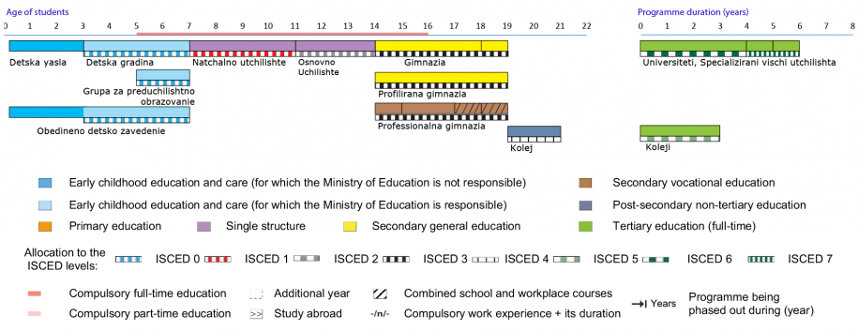
Educational System in Bulgaria
Grades 1 2 3 4 5 6 7 8 9 10 11 12
National evaluation
Entrance to the next level
National evaluation
Matura
Competitions in maths for entrance in Math. Gymnasiums
Educational Ecosystem
Mathematical and Natural science Gymnasiums
https://webgate.ec.europa.eu/fpfis/mwikis/eurydice/index.php/Bulgaria:Overview
Notes:
Mandatory from the age of 7 or from the age of 6 according to parents’ decision till the age of 16.
Schools are state, municipal, private or religious.
According to the type of training, schools are non-specialized and specialized.
According to the stage or level of education, non-specialized schools are:
primary (I - IV grade inclusive);
main (I - VII grade inclusive);
highschools (VIII - XII grade inclusive);
united (I - X including grade);
secondary (I - XII grade inclusive).

Slide 4
Main components of educational ecosystem for Computer science education
Main Actors
Students
Teachers
Parents
Policy and Decision Makers
Researchers and teachers’ trainers
Teacher training
Teacher’s qualification - University
Short term trainings – Universities, IT companies, Private training companies and NGO’s
State Policy
National regulation
Curriculum
National programs
Support
Textbooks – provided by publishers and approved by Ministry of education
Interactive e-learning content – publishers, teachers, database provided by ministry of education
Location
Schools – state or private
IT companies
NGO’s
Private training companies
Educational Ecosystem

Slide 5
Regulations of educational process
State standards
Syllabus for every grade
Topic schedules for the academic year
outline competences in form of learning outcomes (LO) for every educational level
developed by the Ministry of Education;
developed by teachers.
unified form for description;
outlines the learning outcomes;
compulsory topics;
requirements for distribution of hours for different type of lessons and assessment;
suggestions for activities that help to achieve LO and development of 9 competences;
State policy

Slide 6
Regulations of educational process
Elective or optional courses
Textbooks
Requirements for teachers
teachers develop own syllabus, that have to be approved by regional educational inspectorate.
approved by Ministry of education;
State requirements for obtaining teacher qualification
free of charge for students from 1st till 7th grade, electronic versions available for all;
e-textbooks with extended interactive exercises are provided by the publishers of printed textbooks.
Requirements for teaching Computer science subjects in primary schools – primary school teachers, teachers in informatics and ICT
State policy

Slide 7
Education in Computer science (Informatics) – timeline
End of 60th of XX century
Mathematical Gymnasiums
1979
Research Group of Education
27 schools involved Logo
1981-1986
Experimental education with computer classes
algorithms, programming
8 bit computers
1986/1987
Compulsory subject Informatics in 10th and 11th grade
Basic or Logo
1991-1994
Decrease of hours per week
Removal of subject Informatics in vocational schools
State policy
1994/1995
Involving 6 curricula for Informatics
2000/2001
Two compulsory subjects
2006/2007
Compulsory - Information Technology from 5th till 10th grade, Informatics in 9th and/or 10th
2016 – start 2018/2019
New compulsory subject for primary school – Computer modelling in 3rd and 4th grade
2021/2022
New Subject – Computer modelling and IT in 5th- 7th grade, Includes block based and script based programming – Python or Java Script
Dependent on the equipment of schools
Informatics in 9th grade
Information Technology – in 9 and 10 grade
Elective IT for primary schools (2003/2004)
New curricula for CS at high schools

Slide 8
Current Subjects in Computer science in Bulgarian schools
School Level | Compulsory | Elective/Optional
Primary – 3rd – 4th grade | Computer modelling – from 2018/2019 – 1 hour per week (36 hours per year) | IT – from 2003/2004 1 or 2 hours per week, computer graphics, word-processing, presentations, internet, animations
Low Secondary - 5th – 7th grade | Computer modelling and information technology, 2021/2022, 1,5 hour per week (51 hours per year) | IT – 1 or 2 hours per week Computer modelling Robotics, Animation
Upper Secondary school – 8th – 10th grade | Informatics - 8th grade (for some schools) – 2 hours per week, before 2017 in 9th and 10th grades – 1 hour per week IT - 1 hour per week, | Informatics IT
High School – 11th -12th grade |  | Informatics IT, at least 4 hours per week in specialised schools
State policy

Slide 9
Syllabus “Computer Modelling” 3rd grade
The accent Obtaining knowledge and skills for:
working with digital devices;
working with files;
creating animated projects using algorithms with loops in visual environment for block programming;
safe and healthy working with computers.
Implementation of the computer models in visual environment could be prepared by:
unplugged activities with visual materials – mosaic, jigsaw etc.;
working in simulation environment;
performing algorithms in programming environment;
etc.
State policy

Slide 10
Syllabus “Computer Modelling” 3rd grade
Topic 1. Digital devices
Topic 6. Text and sound in visual environment
Topic 7. Animations
Topic 2. Digital identity
Topic 3. Constructing sequential actions
Topic 4. Constructing repetitive actions (loops)
Topic 5. Visual programming environment
State policy

Slide 11
Syllabus “Computer Modelling” 4th grade
Working with information and digital devices - working with files; creaing animated projects using branching algorithms and synchronising activities of the characters in visual environment for block programming; safe and healthy work with computers;
Implementation of the computer models in visual environment could be prepared by well known to the students visual materials and tools, unplugged activities;
Creating quizzes, jigsaw puzzles and games and managing robotic devices in programming environment;
Becoming aware of the advantages and disadvantages of digital devices for the environment.
Demonstrating responsible attitude towards the digital technologies and the ethical and safe behaviour in the online environment.
State policy

Slide 12
Syllabus “Computer Modelling” 4th grade
Topic 1. Information
Topic 6. Development of educational games
Topic 2. Digital identity
Topic 3. Branching algorithms
Topic 4. Working in visual programming environment
Topic 5. Programming devices
State policy

Slide 13
National programmes
ICT in education
Education for tomorrow day
Innovative schools
Digital backpack
Provides hardware equipment, software, internet connection for school, e-learning environments etc.
Funds extracurricular clubs for development of digital competences; training of teachers to use ICT in education or to teach computer science subjects; development of interactive educational content by teachers
Most schools apply innovative approaches regarding computer science education – increasing the number of hours for computer programming, robotics, educational computer games etc, as elective courses.
New programme, will start in 2022/2023 – provides e-content and hardware resources for all school subjects.
State policy
Notes:
“ICT in education” – provides hardware equipment, software, internet connections of school, e-learning environments etc.
“Education for tomorrow day” – fund extracurricular clubs for development of digital competences; training of teachers to use ICT in education or to teach computer science subjects; development of interactive educational content by teachers
“Innovative schools” – Most of schools apply innovative approaches regarding computer science education – enlarge of classes for computer programming, robotics, educational computer games etc.
“Digital backpack” – new programme, will start at 2022/2023 – provides of e-content and hardware resources for all school subjects

Slide 14
Where computer science is being taught?
Schools – state or private
Apply state syllabuses in mandatory courses
Include extracurricular courses in the frames of National programmes – robotics, programming etc.
IT companies
NGO’s
Private training companies
Use own syllabuses
Usually parents pay for the training
Include more hours per week for computer modelling or ICT in the school curricula
Courses in block programming, robotics;
Prepare students for national contests in computer science
Prepare students for national contests in computer science
Location

Slide 15
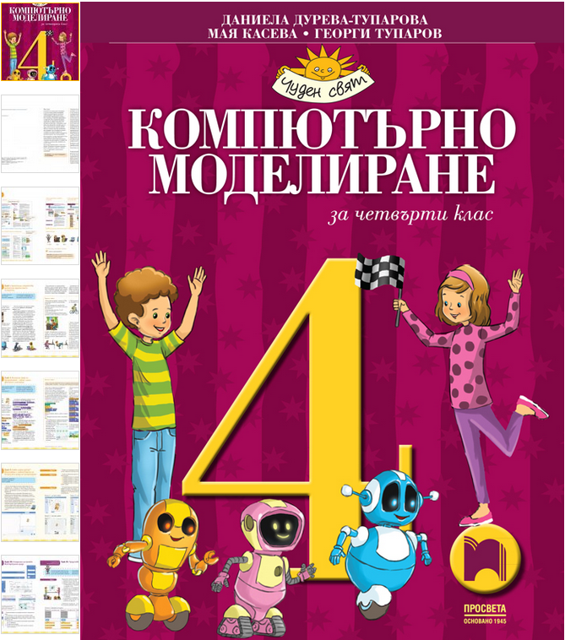
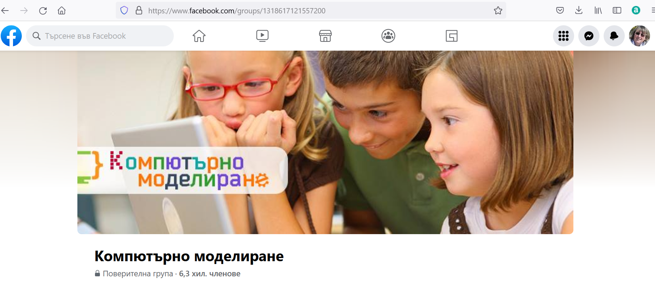
What kind of support do students and teachers have?
Textbooks
Provided free of charge through the schools;
Interactive e-learning content
Provided by publishers of textbooks – every publisher provides free and/or paid e-content
Developed by teachers and published in National e-library, supported by Ministry of Education
Online environments – well known environments like https://code.org/ , https://scratch.mit.edu/ https://bg.khanacademy.org/ ;
Bulgarian online environments - https://ucha.se/ - part of the lessons are free of charge
Approved by Ministry of Education;
Supplemented by online content, disks with resources and working book;
6 textbooks for 3rd and 6 for 4th grade are approved by Ministry of Education
Every tree years schools order new textbooks
Support for teachers
Teacher’s books with methodological learning sheets for lessons;
Social community of teachers in Computer modelling
Facebook group of teachers in Computer modelling with more than 6300 members
Support

Slide 16
Who can teach computer science subjects in primary school ?
Teacher pre-service training
Universities – Bachelor and Master degree programmes:
In-service teacher training
Universities with accredited specialities related to the school subject
Teacher in informatics and ICT
ICT in Primary school
Teacher in mathematics and informatics
One year post diploma qualification for obtaining qualification to teach ICT and Informatics in school:
Teachers in another subjects;
Graduates in engineering, economics, physics, chemistry
Primary school education (without focus on the ICT)
IT companies, Publishers, Private training companies, NGO’s with programmes for teacher’s qualification approved by Ministry of education
Teachers obtain credits for qualification 1 credit = 16 hours training
Internal trainings at the schools
Teacher training

Slide 17
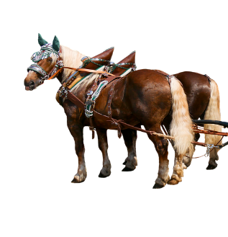
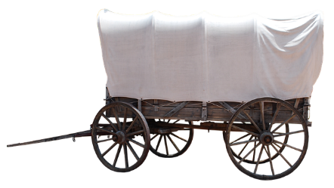
Not enough prepared teachers
At the beginning (2018/2019) Computer modelling had to be taught only by primary school teachers, regardless of their qualification in ICT; Most of the teachers were scared by the new subject and didn’t have the necessary knowledge and skills in programming and algorithms
Decision
Challenges and decisions
Organising short-term courses for teachers;
Self-training by some teachers
Change in state requirements for teachers in Computer modelling (2020) – now teachers in informatics and ICT can also teach Computer modelling in primary school
It seems that the cart is before the horses.

Slide 18
Complex requirements for the teachers’ competences
Information technology
Algorithms and programming languages
Integration of knowledge from all school subjects in primary school
Being aware of the psychological and pedagogical characteristics of the primary school students
Working with parents
Life long learning skills
Application of diverse and adequate educational approaches
Challenges and decisions
Decision
In-service training courses provided by Ministry of education, universities, private companies and NGO’s
Master degree programmes related to ICT in primary schools; Including courses in Computer modelling and teaching methods in Bachelor degree curriculums

Slide 19
Equipment
Needs of enough computer labs in the schools
Needs of robotic devices
Schools apply for funding in National programmes or pay with own budget
Decision
Challenges and decisions

Slide 20
Abstract concepts
Branched algorithm
Information
Loop
Data
Logical operators
Challenges and decisions
Algorithm
Arithmetic operators
Variable
Digital identity
Random number
User
Broadcast

Slide 21
Use of mathematical concepts part of curricula in next grades
Coordinates and coordinate system
Random number
Negative numbers
Challenges and decisions
Measurement of angles
Notes:
Implementation of basic concepts and main topics of the syllabus requires usage of concepts that are part of mathematics curricula in next grades - negative numbers, coordinates and coordinate system, measurement of angles in degrees, random number.

Slide 22
Didactical approaches for solving of the challenges
Explaining concepts by examples.
Focus on the properties of the concepts.
Use of analogies and examples from everyday life and tales.
Use of fun elements - challenges, riddles, anecdotes, puzzles.
Use of computer educational games, simulations or demonstrations.
Interactive tests and electronic textbooks.
Use of unplugged activities.
Problem solving
Experiments with “baked” code and completing of “half baked” code.
Challenges and decisions

Slide 23
Which are the most difficult topics for the students? – Teachers’ opinion
Questionnaire with teachers
Participants – teachers in Computer modelling and IT 3. – 7. grade
Number – total of 71: 20 of them teach in Primary school; 32 only in 5th grade; 19 have no experience in teaching Computer modelling
Before in-service training, June-July 2022
Limitation – not representative
Challenges and decisions
The teachers were asked to mention the most difficult topics for the students:
Branching algorithms;
Logical operations;
Variables
Synchronisation of sprites’ actions

Slide 24
When to start learning computer modeling? - Teachers’ opinions
Challenges and decisions

Slide 25
What needs to be changed? – Teachers’ opinion
Ministry of education conducted wide study across teachers, parents and students regarding needs of changes in school curricula (https://www.mon.bg/upload/32511/ucheb-programi-predlojeniya-28072022.pdf )
Students mention that Computer modelling and ICT are one of the easiest and most pleasant school subject;
Focus group of teachers suggests “Building a branching algorithm for a given task” to be moved in 5th grade (?!)
No available data from teachers’ questionnaire
Challenges and decisions

Slide 26
Next steps
Before 30 October 2022 we expect changes in Computer modelling curricula
Тhe aim is to ease the learning content
Crucial component in successful implementation of computer modelling in primary schools is teachers’ qualification, experience, and competences
The efforts of all stakeholders should be directed to pre-service and in-service teacher trainings
Development of more didactical resources to support teachers and students
Study the reasons for some negative attitudes of the teachers regarding involvement of computer modelling in primary school
Challenges and decisions

Slide 27
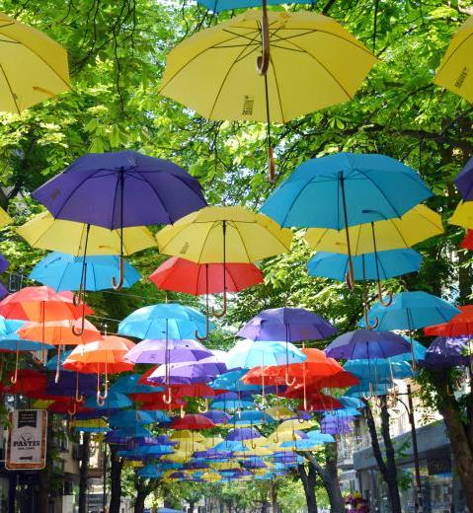
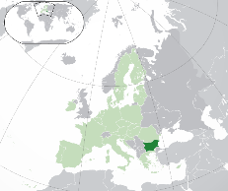
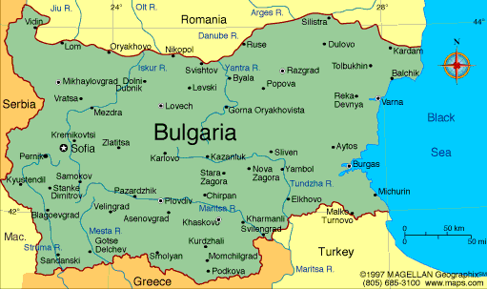
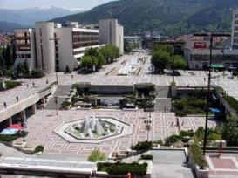
Thank you for attention!
Daniela Tuparova
Department of Informatics
South-West University “Neofit Rilski”
Blagoevgrad 2700
Bulgaria
E-mail: ddureva@swu.bg
Daniela.tuparova@gmail.com

